Slide 1
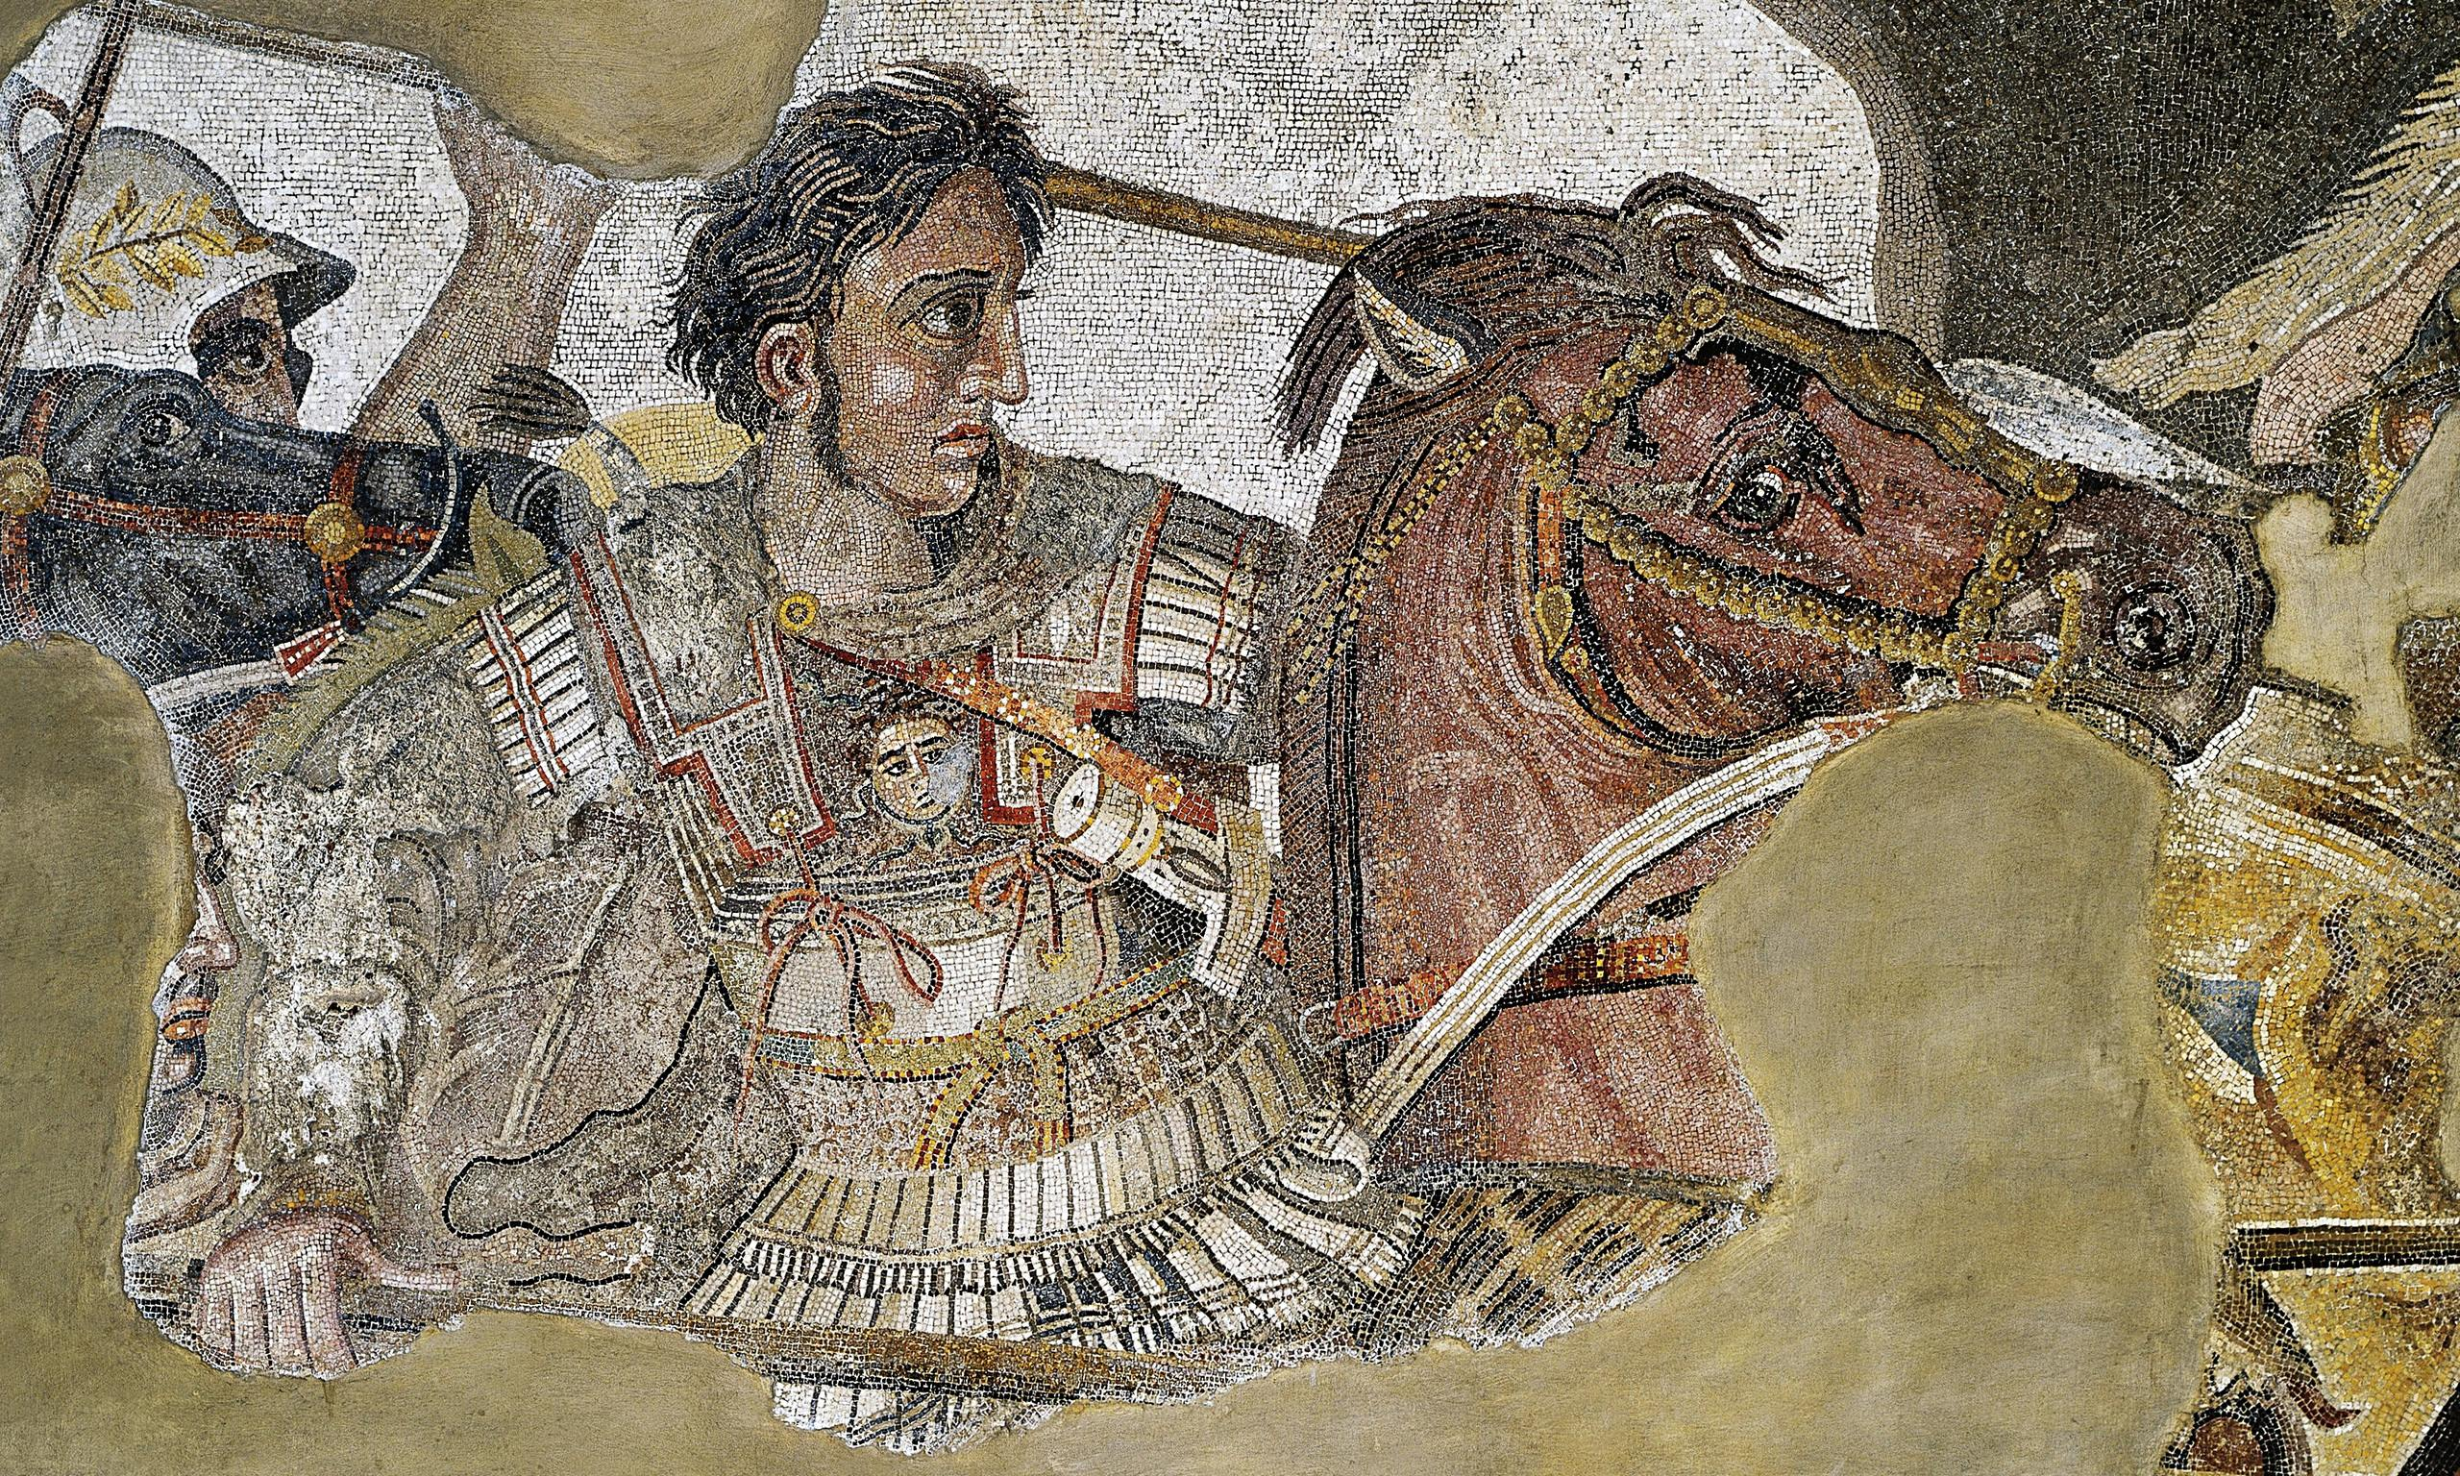
The Rise of Alexander the Great
Goal/s:
Identify the causes of the rise of atg
Week 9 Lesson 2 – unit 2
Ms Barrie

Slide 2
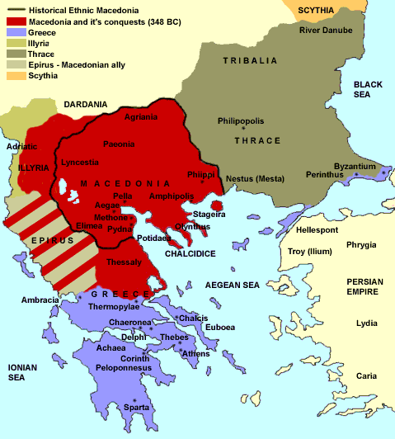
Early Life
Alexander III of Macedon was born on the 21st July 356 BCE
His father was King Philip II of Macedon and his mother was Olympias, a princess from Epirus
He called himself the son of Zeus, making himself into a demi-god
Apparently, Olympias told him that Zeus had visited her at night

Slide 3
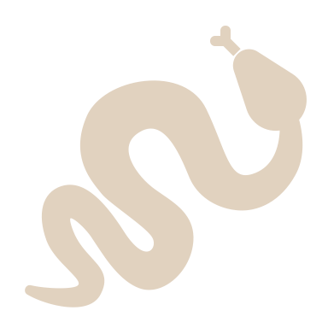
“…a serpent was once seen lying stretched out by the side of Olympias as she slept, and we are told that this, more than anything else, dulled the ardour of Philip's attentions to his wife, so that he no longer came often to sleep by her side, either because he feared that some spells and enchantments might be practised upon him by her, or because he shrank from her embraces in the conviction that she was the partner of a superior being”
Plutarch, Alexander, 2.

Slide 4
Early Life
His best friend was another boy called Hephaestion
When he was 12 years old, Alexander apparently tamed the wild horse Bucephalus
When he turned 14, Philip paid a huge sum of money to the famous Greek philosopher, Aristotle, to become Alexander’s personal teacher for three years
When he turned 16, Philip gave him military command. He had successful campaigns against Thrace

Slide 5
Philip’s military expansion into Greece had brought peace
However, the poleis resented having to be under the control of a ‘barbarian’
In 340 BC, the Athenian orator Demosthenes inspired a new coalition of Greece cities to revolt against Macedon
“Philip the king, having won most of the Greeks over to friendship with him, was ambitious to gain the uncontested leadership of Greece by terrifying the Athenians into submission”
(Diodorus Siculus, Library of History, XVI.84)

Slide 6
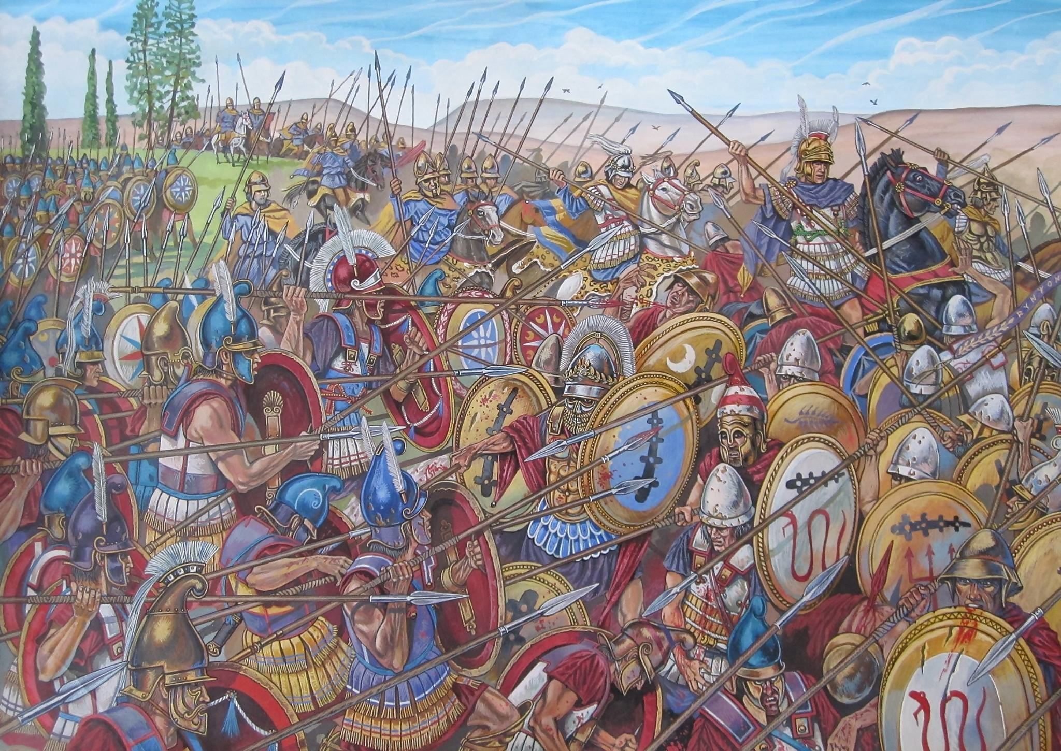
The Battle of Chaeronea (338 BC)

Slide 7
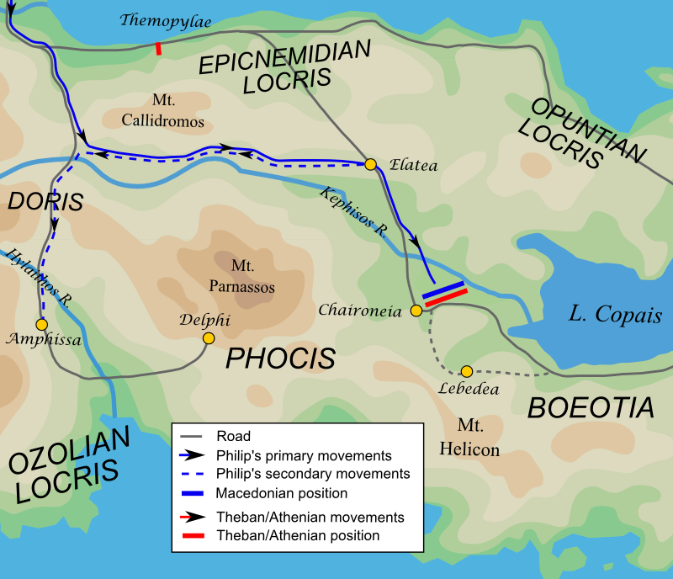
Philip led a force of 30,000 infantry and 2,000 cavalry
The Greek cities of Athens, Thebes, Corinth and others, had 35,000 infantry
This included the Theban ‘Sacred Band’, an elite force of 300 fighters

Slide 8
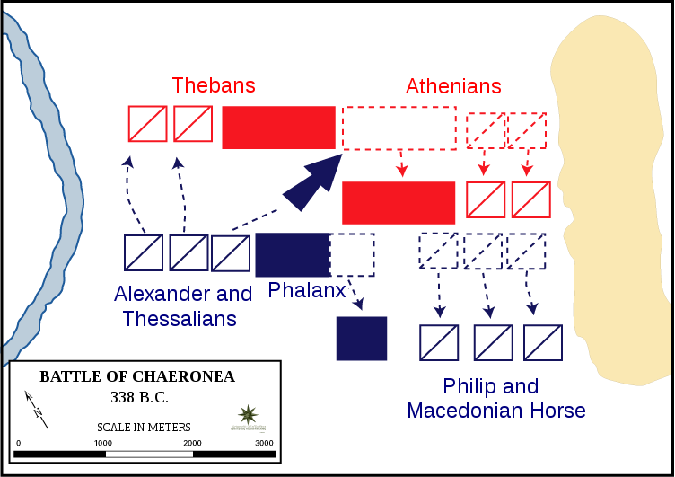
Philip placed Alexander, on the left, opposite the Sacred Band The Macedonian phalanx occupied the centre, facing the allied Greek infantry. Philip took positions on the right, across from the Athenians. Philip drew the Athenians out of position with a feigned retreat. This opened a gap between the Greek centre and the Thebans Alexander, at the head of Philip’s hetairoi (“Companion”) cavalry, charged through. The Greeks were surrounded and defeated.

Slide 9
Thebans
Thebans
Athenians
Athenians
Thessaly Cavalry
Macedonian Phalanx
Macedonian Phalanx
Macedon Cavalry
Alexander
Philip II

Slide 10
Thebans
Thebans
Athenians
Athenians
Thessaly Cavalry
Macedonian Phalanx
Macedon Cavalry
Alexander
Macedonian Phalanx
Philip II

Slide 11
Thebans
Thessaly Cavalry
Thebans
Athenians
Athenians
Macedonian Phalanx
Macedon Cavalry
Alexander
Macedonian Phalanx
Philip II

Slide 12
Alexander
Thebans
Thessaly Cavalry
Thebans
Athenians
Athenians
Macedonian Phalanx
Macedon Cavalry
Macedonian Phalanx
Philip II

Slide 13
Thebans
Alexander
Thessaly Cavalry
Thebans
Athenians
Athenians
Macedonian Phalanx
Philip II
Macedon Cavalry
Macedonian Phalanx

Slide 14
The unbreakable discipline of the Sacred Band caused its annihilation Surrounded and unwilling to surrender, they were massacred Archaeological excavations near the city of Chaeronea uncovered 254 skeletons found buried beneath a funerary marker, buried in pairs.

Slide 15
Philip made peace with the cities and installed garrisons
In 337 BC, he establish the League of Corinth: an agreement of peace in Greece, and promises of military assistance against Persia
All poleis signed up to the league, except Sparta
In 336 BC, Philip was assassinated by the captain of his bodyguards, Pausanias.
Pausanias was killed while trying to escape
Alexander was proclaimed king at the age of 20
Thrace and Greece revolted but Alexander moved quickly to suppress them

Slide 16
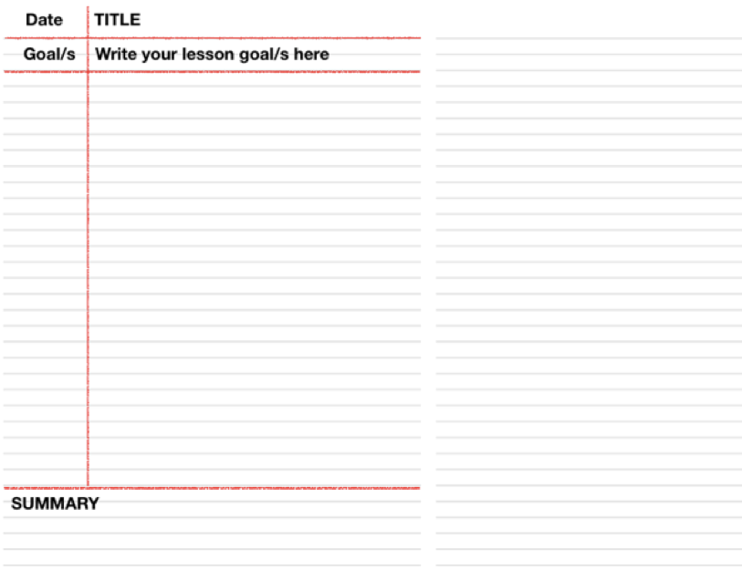
ACTIVITY – Summary Task
Write information about Alexander The Great on the Task Sheet.
Glue this in your book once complete.
GLUE ON THIS PAGE

